Slide 1
Food Safety
Introduction
Globally, food safety issues are of top priorities to the food industry, government food safety regulators, and consumers as a result of a significant increase in the number of foodborne disease cases in the 20th century.
These issues led to the reproduction of several food safety programs designed to reduce the incidence of foodborne illness.

Slide 2
Introduction
The occurrence of foodborne illness from emerging and existing pathogens remains a challenge to the food industry and food safety regulators.
Food safety begins on the farm and continues through processing, transportation, and storage until the food is consumed.

Slide 3
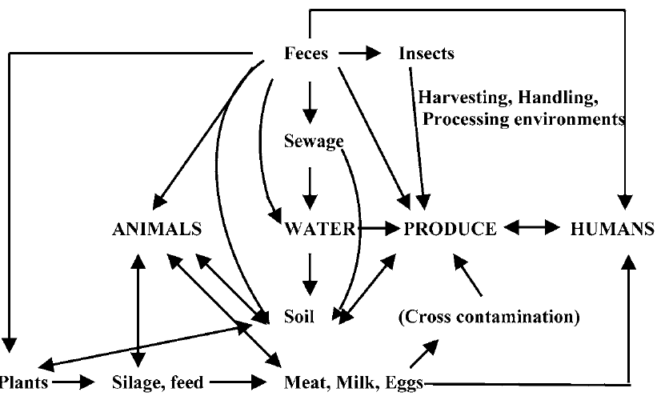
Potential sources of on-farm contamination of fruits and vegetables are summarized in Figure below.

Slide 4
categories of food safety concerns
The three main categories of food safety concerns in the food industry include microbiological, chemical, and physical hazards.
The microbiological hazards are those involving foodborne pathogens.

Slide 5
chemical hazards include concerns related to antibiotics, pesticides, and herbicides.
and physical hazards are those related to foreign objects in foods that can result in injury or illness when consumed with foods.

Slide 6
Control Measures for Microbial Contaminants
A combination of factors is normally responsible for occurrence of an incident of foodborne illness.
Control measures to ensure food safety include.
(1) prevention of contamination of foods by pathogenic organisms.
(2) inhibition of growth or elimination of pathogens in foods and food products.

Slide 7
The first stage of control measures is to prevent contamination of food animals and plants during the production stage. The use of manure and other organic fertilizer materials can provide the vehicle for contamination of food crops; hence, it is important to ensure that this type of fertilizer is pathogen free prior to use.

Slide 8
The second stage of control measure is to prevent contamination and growth of pathogenic organisms during harvesting and transportation of food products. It is generally believed that control of microbial contamination early in production is more effective than control measures applied at a later stage of production.

Slide 9
A combination of intrinsic factors, (i.e., factors associated with the properties of the food) and extrinsic factors (i.e., factors associated with external conditions)
external conditions is often used during processing and storage to control microbial growth in foods.

Slide 10
Intrinsic factors such as the pH, water activity, and food components can promote or inhibit microbial growth or survival.
These properties can be used in combination with extrinsic factors such as heat, preservatives, irradiation, and storage conditions (e.g., refrigeration, relative humidity, etc.).

